Slide 1




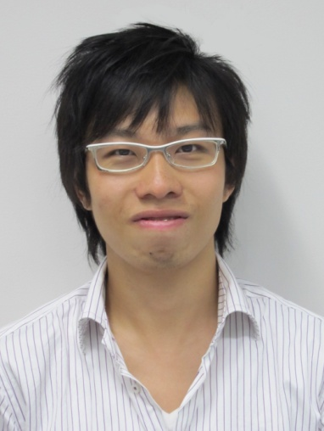

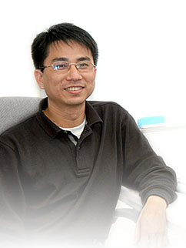
Identity-Based Encryption Resilient to Continual Auxiliary Leakage
Tsz Hon Yuen
Sherman Chow
Ye Zhang
Siu Ming Yiu
Hello everybody!
Hope you like
our slides
See you at the next conference!

Slide 2
Outline
Problem Statement
Identity-Based Encryption w/ Auxiliary Inputs
Our Techniques
Continual Auxiliary Leakage (CAL) Model

Slide 3
Side-Channel Attack
The central notion of modern cryptography relies on the secrecy of the secret key.
In practice, this paradigm is subject to the immanent threat of side-channel attacks.

Slide 4
Leakage-Resilient Cryptography
Formal security guarantees even when the secret (key/randomness) leaks
Here we only consider memory leakage.
The adversary is allowed to specify an efficiently computable leakage function f
  Obtain the output of f applied to the secret
  Aims to model the possible leakage in practice
Notes:
Was introduced to provide… when the leakage of … internal state … is allowed
In this talk, we focus on security against…. In particular, we do not consider active attack like fault attacks which tamper the algorithm.
This function f aims to model the possible leakage that the adversary can learn in practice.

Slide 5
A Major Open Problem
[Goldwasser @ Eurocrypt ‘09 Invited Talk]
allowing for continuous unbounded leakage
without additionally restricting its type
[AGV09, NS09, ADNSWW10, BKKV10, CDRW10, DGKPV10, DHLW10, LLW11, LRW11…]

Slide 6
Restrictions of Leakage
Output < l bits [AGV09]
Lower the entropy by < l bits [NS09]
i.e., l as a fraction of the key (bit-size/entropy)
Notes:
overall unbounded
the type of leakage

Slide 7
Bounded Retrieval Model
Allowed bits of leakage is l
l is also a system parameter
Size of the secret key increases with l
But l does not affect public key size, communication and computation efficiency
e.g., [ADNSWW10, CDRW10]
Hope the attack is detected and stopped before the whole secret is leaked

Slide 8
Auxiliary Inputs
Any f that no poly. time adversary can invert
E.g., One-way permutation (OWP)
OWP is not allowed in the relative model
[DGKPV10] proposed public-key encryption (PKE) schemes with auxiliary inputs
All these bound the leakage throughout the entire lifetime of the secret key

Slide 9
Continual Leakage Model
Allows for continuous memory leakage (CML)
Continually updates / refreshes the secret key
Leakage between updates are still bounded
[DHLW10]: signature and identification
[BKKV10]: signature, PKE, and selective-ID IBE
[LLW11]: signature and PKE
  allows a constant fraction leakage of the secret key and the randomness during updates

Slide 10
IBE with Auxiliary Inputs
IBE found many applications
Resilience => composition of ID-based systems
A “clean” security definition
  Free from numeric bounds
  E.g. # of bits leaked from the master secret key
Notes:
Anonymous IBE, chosen-ciphertext security, verifiable random function, password-based key exchange
as long as other schemes were proven secure In the standard no leakage sense
With the versatility of ID-based keys this guarantee appears to be more desirable
Or # of bits leaked from the ID-based secret key of the target user

Slide 11
Continual-Leakage-Resilient IBE
Current CML models for IBE consider leakage of the current secret key for a given time only
  [BKKV10, LRW11]
The old secret key should be securely erased.
Less disastrous leakage => Less benefits
Notes:
In other words, after a user has computed a new secret key for the next time period
from memory, so the leakage via the key-update query is the ``last chance’’ for the adversary.
With frequent secure erasures, it is less disastrous to have memory leakage.
This greatly diminishes the benefits offered by the formal LR guarantee.

Slide 12
Problem Statement
We tackle the problem of “allowing for continuous unbounded leakage, without additionally restricting the type of leakage”.
[DGKPV10]: PKE, no continual leakage
[BKKV10]: selective-ID, no leakage from msk
[LRW11]: adaptive-ID, leakage size bounded
Notes:
Leakage size during updates is limited to logarithmic

Slide 13
Our Contributions (1)
We propose the continual auxiliary leakage (CAL) model
Minimal restriction: no polynomial time algorithm can use the leaked information to output a valid ID-based secret key
Can leak from all refreshed master secret keys and ID-based secret keys
  “Cleaner” model: no “version number” of keys
“Ultimate model” for IBE?

Slide 14
Our Contributions (2)
We propose the first IBE scheme that is secure in the presence of auxiliary inputs
  Adaptive security in the Standard Model
  Based on Static Assumptions
  Moderate costs (ctxt. size, comp. complexity)
  (all these’re “nice” features of [CDRW10, LRW11])

Slide 15
Goldreich-Levin Theorem
The key technique in [DGKPV10] is the modified Goldreich-Levin (GL) theorem.
The original GL theorem is over GF(2)
  For an uninvertible function h: GF(2)^{m} -> {0, 1}*,
  <e, y> ∈ GF(2) is pseudorandom
  given h(e) and uniformly random y

Slide 16
Modified GL Theorem
Let q be a prime
H be a poly(m)-sized subset of GF (q)
h : H^{m} → {0,1}* be any (randomized) function
If there is a PPT algorithm D that distinguishes between <e, y> and the uniform distribution over GF(q) given h(e) and y ← GF(q) ^{m}
then there is a PPT algorithm A that inverts h with probability 1/(q² · poly(m))

Slide 17
Aux-PKE -> Aux-IBE
A λ-bit number is used as the (real) secret key.
Allows leaking uninvertible function of sk
“Inner product” of sk and ephemeral randomness of ctxt. hides the message
Distinguisher => Invertor in time O(poly(λ))
ID-based secret key has “structure”
  Not a λ-bit number
  Secret random factors from a small domain
  => Brute-force attack
Notes:
Exponentially large field GF(q)

Slide 18
Aux-PKE + LR-IBE -> Aux-IBE?
Even worse, many many secret keys in IBE…
Leak “semi-functional” (SF) keys in simulation
SF-key is perturbed from a real key by m blinding factors from Z_{p} where p is of size 2^{λ}.
Inefficient invertor if we followed [LRW11]
Countermeasure for leakage just appears in the security proof but not the actual scheme.

Slide 19
Our Auxiliary Input Model
Usual adaptive-ID security for chosen-plaintext attack (CPA)
Leakage oracle (LO) in additional to Key Extraction oracle (KEO)
LO takes an input of f ∈ F and ID returns f(msk, sk_{ID}, mpk, ID)
No LO query after challenge phase
F: Given mpk, ID*, {f_{i} (msk, sk_{IDi}, mpk, ID_{i})}, and a set of secret keys w/o sk_{IDi}, no PPT algo. can output a secret key sk_{ID*} of ID*
Here are the parameters, I will keep msk from you
I want f0(msk), f1(sk_{ID1}), sk_{ID4}, sk_{ID1} and f3(msk, sk_{ID4})
Sure, just make your adaptive choices
I want to be challenged with these 2 messages: m₀, m₁
Now I encrypt a random 1 of them, make your guess

Slide 20
Length-bounded Leakage for IBE
We combine the 2 separate leakage oracles.
Allow leakage from msk and sk_{ID} at the same time(, and may share the same randomness)
We do not need to store the amount of leakage for msk and sk_{ID}, so we don’t need a set of handles of keys as in [LRW10].

Slide 21
Roadmap of Our Construction
Boneh-Boyen Selective-ID IBE
Our IBE with Auxiliary Inputs
Lewko-Waters Adaptive-ID IBE
Lewko-Rouselakis-Waters LR-IBE
Chow-Dodis-Rouselakis-Waters uLR-IBE

Slide 22
Intuitions of Existing Schemes
Lewko-Waters Adaptive-ID IBE
  Dual system encryption technique
  Instantiating BB-IBE in composite order group
  Dual system for adaptive-ID security
Chow-Dodis-Rouselakis-Waters uLR-IBE
  Single user secret key leakage via a single “tag”
Lewko-Rouselakis-Waters LR-IBE
  Multiple “tags” for multiple leakages
  ID-Keys for Undetermined ID = Master Secret Keys

Slide 23
Intuitions of Our Schemes
“Multiplexing” at user-key-level in [LRW11]
We do it at the master-key-level
  or Parallel repetition of Lewko-Waters IBE
How to get leakage-resilience in [LRW11]?
Actually, how to get adaptive-ID security?

Slide 24
Leakage via Dual System
We know how to “fake” everything!
We can leak them too.
Caution: leaking can’t spoil faking.
Correlation regarding SF objects is information-theoretically (IT) hidden
  because the leakage per key is suitably bounded
  conceptually similar to [BKKV10]

Slide 25
Our Design Constraints
Small blinding factors are used in SF key
Rely on IT argument when the key is extracted
  “extending” 1 equation 2 unknowns argument in Lewko-Waters IBE to 3m eq. (3m + 2) unknowns
When the key is leaked, uninvertible function of key can be created from uninv.-func. of factors
Inner product = 0 => Exponent in G_{q} = 0
Use modified GL theorem to ensure the indistinguishability of 2 types of SF keys.
Notes:
How to leverage modified GL theorem?

Slide 26
Our Contributions (3)
First hierarchical IBE with auxiliary inputs
First IBE in Continual Auxiliary Leakage model
  Retain the same order of complexity as [LRW11]

Slide 27
Our Contributions (4)
We extend our basic scheme to support leakage of randomness during setup.
We need a lattice-based assumption (used in a variant of Gentry-Peikert-Vaikuntanathan’s encryption based on learning with error) in our pairing-based construction.
Notes:
average-case problem of inhomogeneous small integer solution problem (ISIS), which is related to the shortest independent vectors problem and decision shortest vector problem [GPV]

Slide 28
Continual Auxiliary Leakage
Setup is split into CRS-Gen and MKeyGen
UpdateMSK and Update USK
Corresponding oracle: UMO and UUO
Phase 1: KEO, LO, UMO
Challenge Phase
Phase 2: KEO, LO, UMO, UUO

Slide 29
Function Family
Basic: Given mpk, ID*, {f_{i} (msk, sk_{IDi}, mpk, ID_{i})}, and a set of secret keys w/o sk_{IDi}, no PPT algo. can output a secret key sk_{ID*} of ID*
CAL: Given mpk, ID*, {f_{i} (L_{msk}, L_{ID}, msk, sk_{IDi}, mpk, ID_{i})}, and a set of secret keys w/o any valid sk_{IDi}, no PPT algo. can output sk_{ID*} of ID*
The lists L’s include all keys ever produced
Additionally, may give leakage during setup

Slide 30
Extensions
CAL-IBE: just re-randomize G_{p} component
HIBE: just replace u^{ID}h to Π_{i}(u^{IDi})h

Slide 31
Leakage during Setup
Matrix of v’s as randomness
Selector bit α_{j} as randomness
Define q_{i} = Πv_{ij}^{α}j
Y = e(g_{i}, q_{i}) as the master public key
n copies of the scheme
n = O(λ), λ is sec. param.

Slide 32
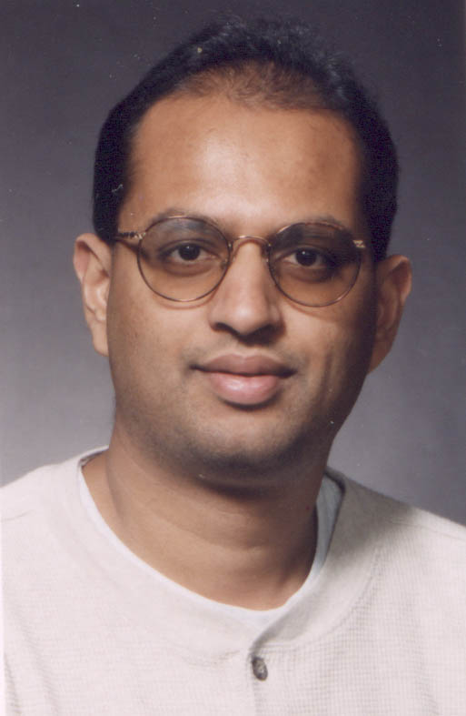
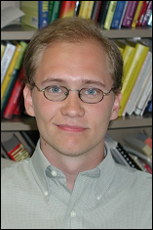
Acknowledgement
Thanks Alfred Menezes and Jonathan Katz for helpful comments.

Slide 33
Summary of Contributions
Leakage
tolerated
Ours
  continual
  auxiliary
  no erasure
Lewko et al. @ TCC ’11
  bounded
  erasure
Brakerski et al. @ FOCS ’10
  bounded
  erasure
  bit-wise
Chow et al. CCS ’10
  bounded
  no update
Waters @ EuroCrypt ’05
Relative complexity

